Slide 1


Network Config Backup
An automated approach using Netbox, Github, and Ansible
Jeremy Schulman
Heading up Network Automation at Major League Baseball
2020-May-19 Netbox Day
@nwkautomaniac

Slide 2

About Me
Jeremy Schulman
Software engineer
Major League Baseball in Neteng team
Prior 20 yrs at various Vendors
@nwkautomaniac - Est. 2012
100% focused on network automation
Open-source & community contributor

Slide 3



Motivation
As a aspect of our Network Reliability Engineering our network device configurations must be automatically backed up on a nightly basis.
These files must be stored in a version controlled system so that we can revert back from a given point in time
We want to be able to examine config changes over time
MLB hosted github
network devices

Slide 4
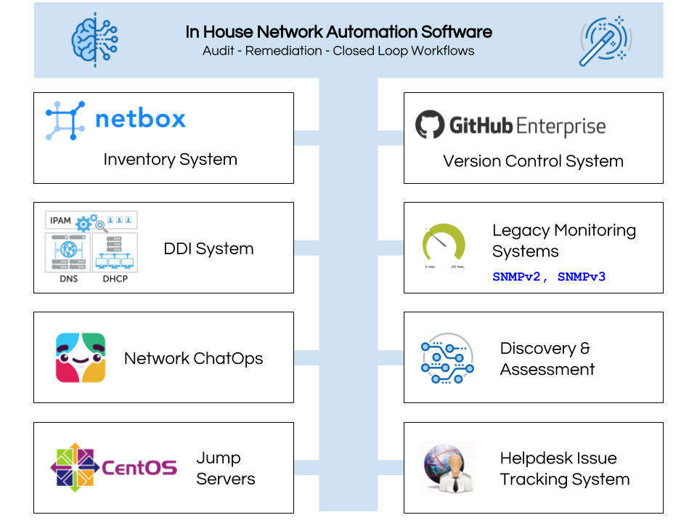
Network automation software is much about integrating various systems together to achieve reliable outcomes.
Custom automation software for audit and remediation is used to ensure data consistency across the systems.
Netbox is automatically updated using data from systems (Monitoring) so that other workflows (Backup) execute as desired; and vice-versa.

Slide 5
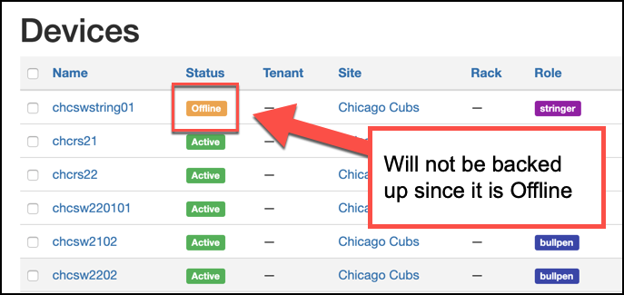
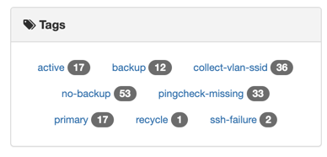
Netbox Usage
Netbox is our authoritative Inventory source-of-truth
Only devices in the Active state are eligible for backup
Netbox also includes non-network devices, such as console servers
Not all devices should be backed up; indicated by a no-backup tag
Devices excluded from backup based on Manufacturer and Device Type

Slide 6
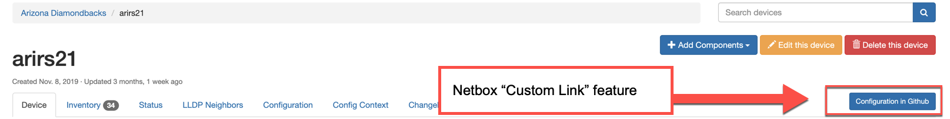
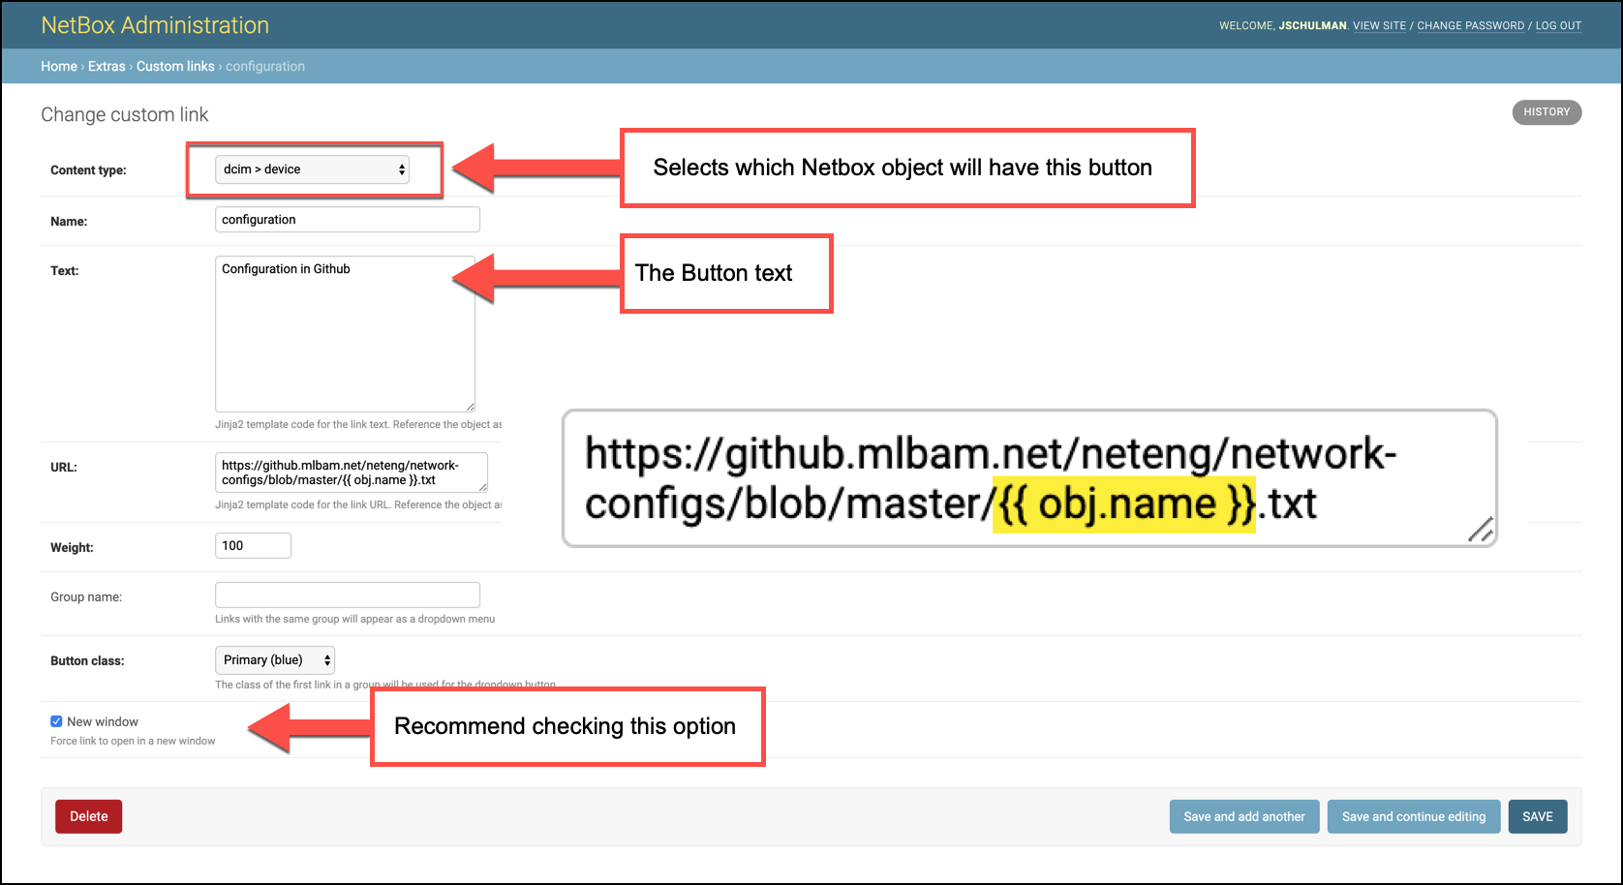
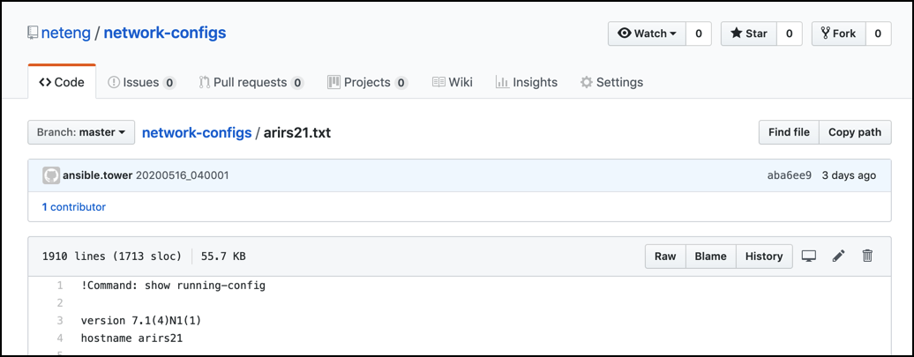
Netbox Custom Link -> Github

Slide 7
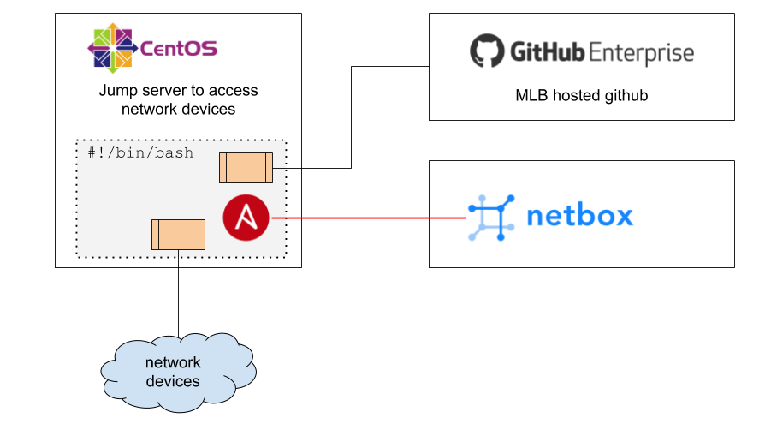
Backup Service
On a jump server a cron job runs a bash script that runs a series of Ansible playbooks that automates the collection of network-configs and stores them into github.
A custom Ansible dynamic inventory script is used to obtain only those devices that should be backed up.

Slide 8
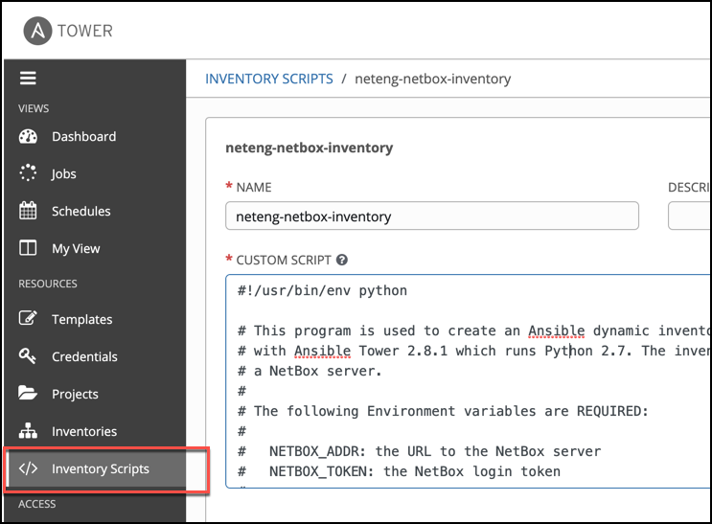
? Custom Ansible Inventory Script
Used with Ansible Tower
Used for Ansible playbooks on Jump-server
Code reuse across other system integration workflows
System integration based variable enrichment
Customized with argsparse

Slide 9
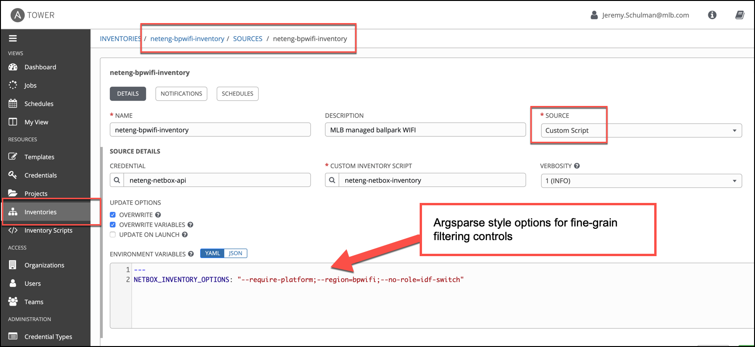
Tower Inventory using Script (1 of many)

Slide 10
Benefits of Using Github
Network configs saved as tagged releases
On Github WebUI
Examine contents of files
Examine differences over time
On CentOS jump-server
Use standard Linux tools (grep) to examine files
Use git commands for finer reporting

Slide 11
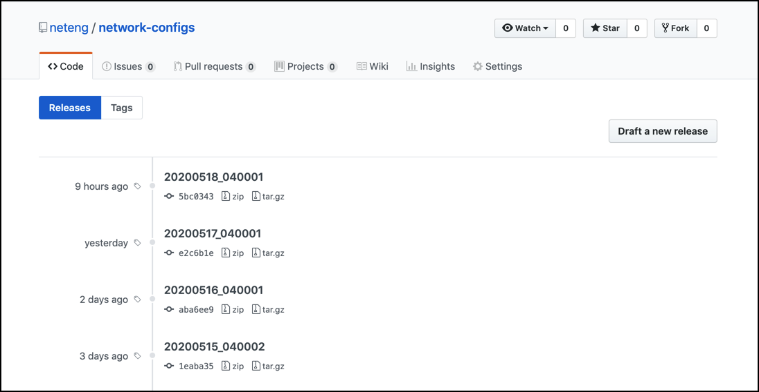
Tagged Releases

Slide 12
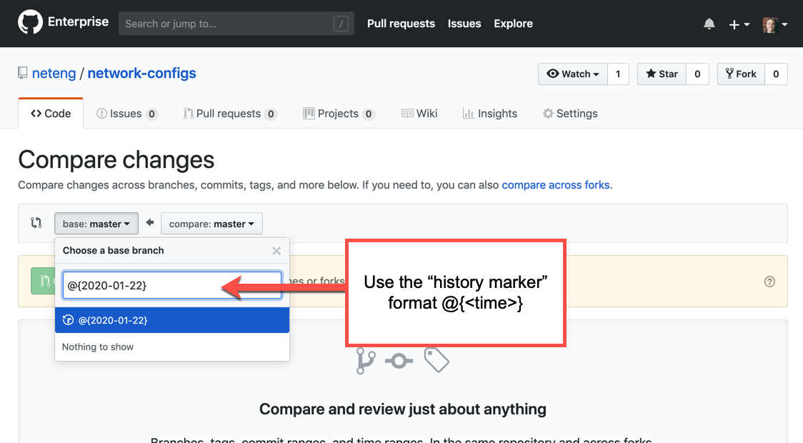
URL: <github repo>/compare

Slide 13
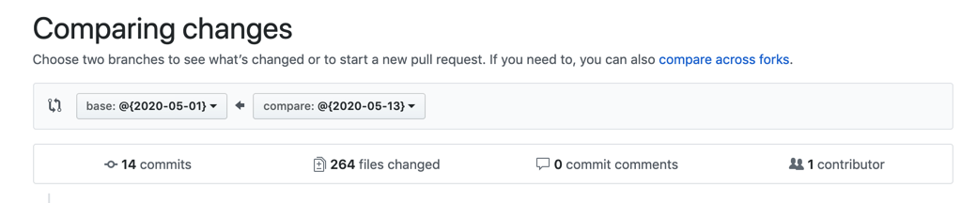
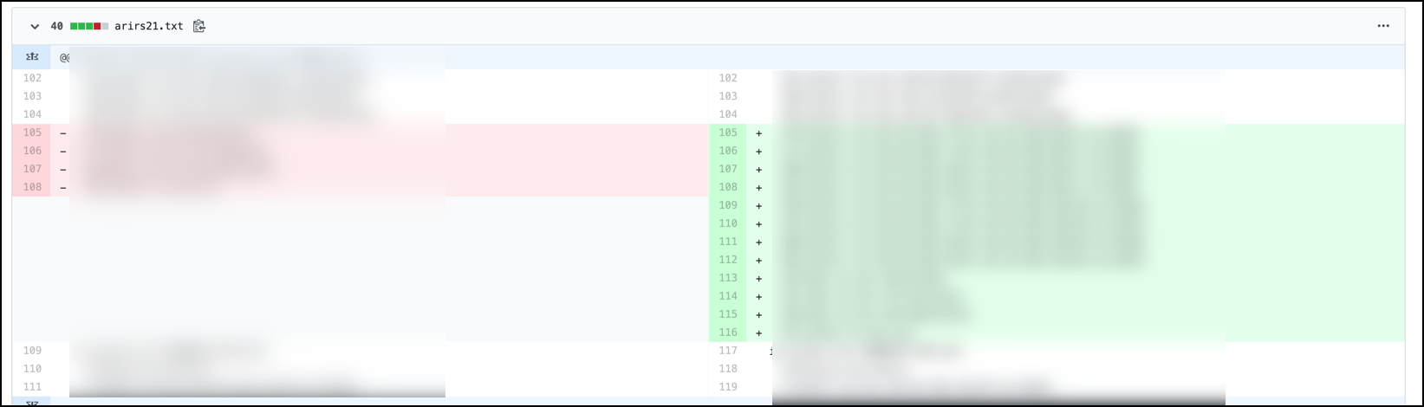
Showing Diffs Between Dates

Slide 14

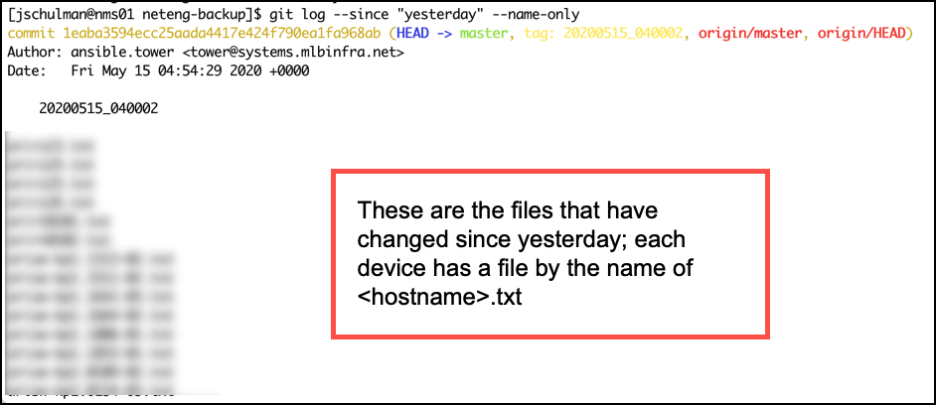
List Devices that Changed
Show the list of devices (files) that have changed since a given date; just the names.
git log --since "yesterday" --name-only

Slide 15
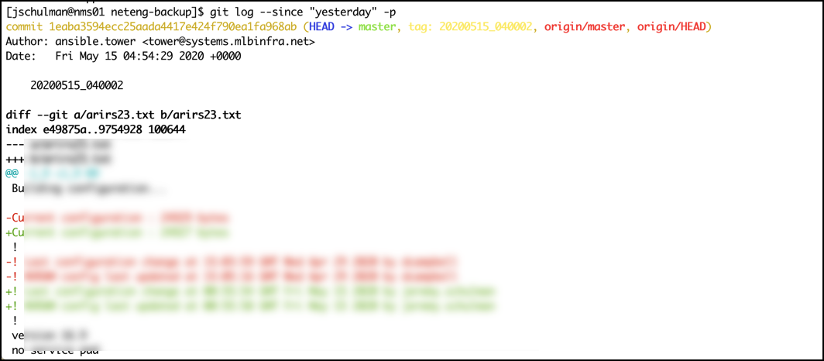
Show Changes as Diff / Patch
Show the list of devices that have changed since a given date; show diff content
git log --since "yesterday" -p

Slide 16
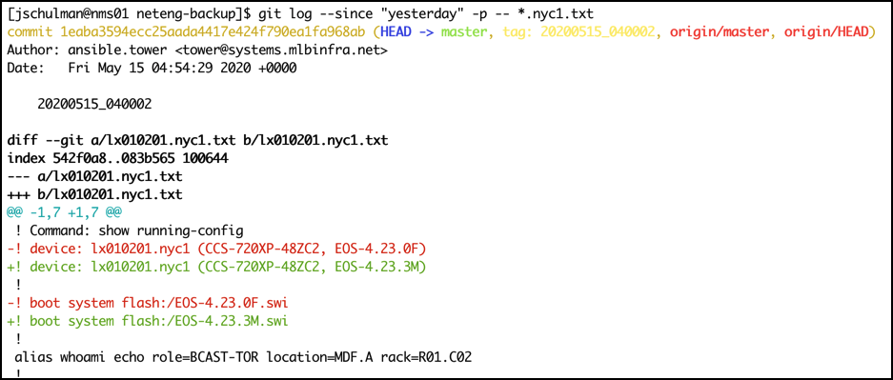
Show Specific Device Changes
Show the list of devices matching a specific filename or file pattern that have changed:
git log --since "yesterday" -p -- *.nyc1.txt

Slide 17
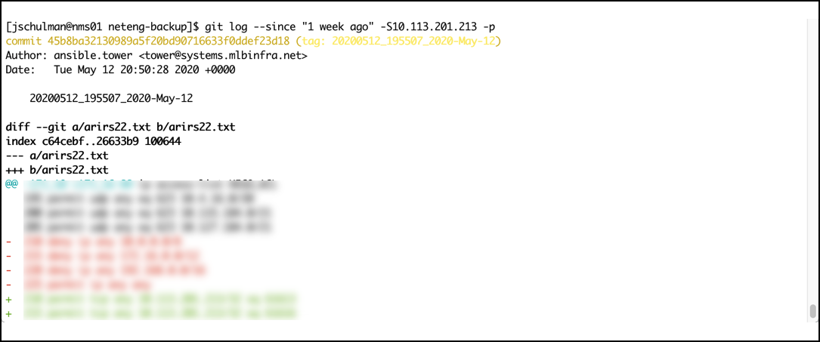
Find Changes With Content
Find any device that has been changed in the last week where the IP address 10.113.201.213 was referenced:
git log --since "1 week ago" -S10.113.201.213 -p

Slide 18



Summary
Netbox + dynamic inventory script for selective backup inventory
Github for version control and change visibility
Ansible
To backup ~ 1800 devices takes ~1hr
Could optimize playbooks
Possibly migrate to Nornir
Notes:
https://github.com/netbox-community/ansible_modules/tree/devel/plugins/inventory

Slide 19
Thank you!
Jeremy Schulman
@nwkautomaniac

Slide 20
BONUS SLIDES

Slide 21
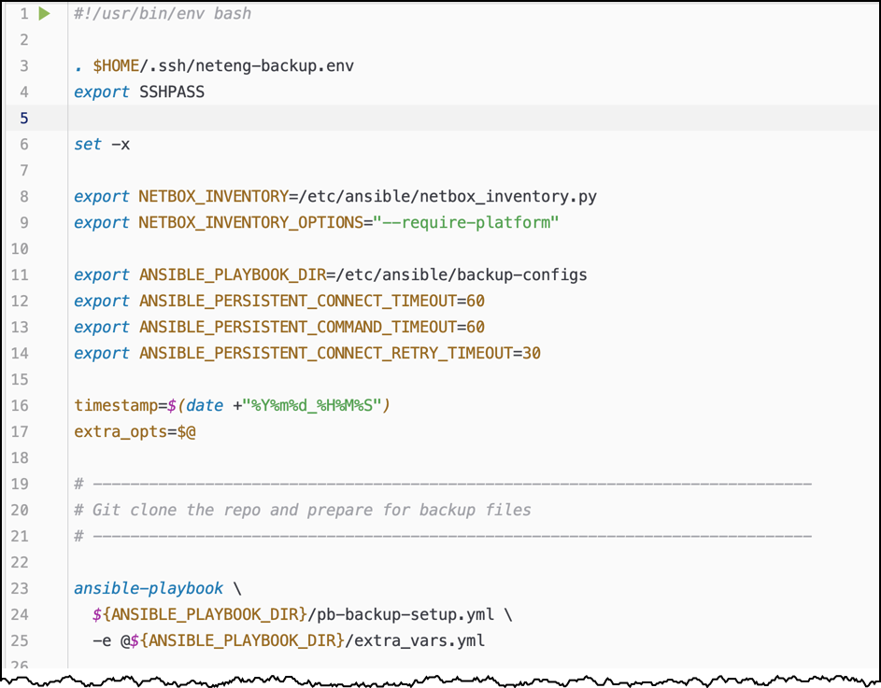
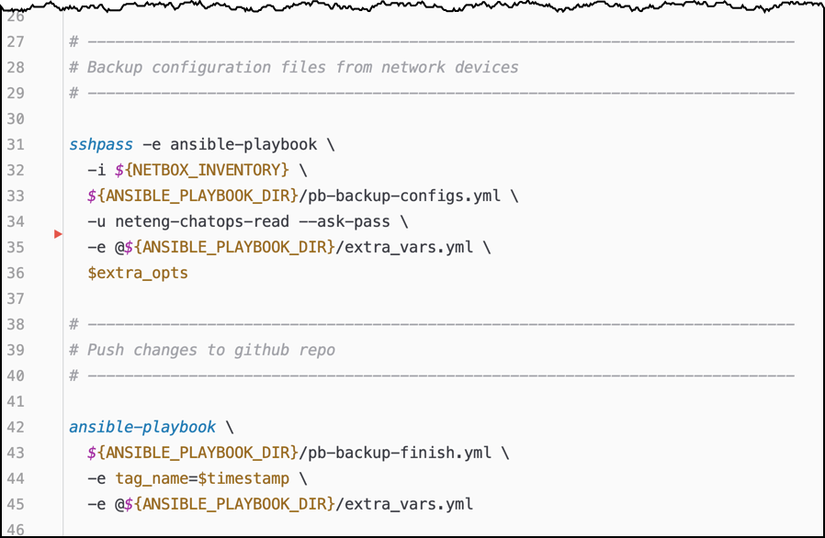
Cron Job Shell Script

Slide 22
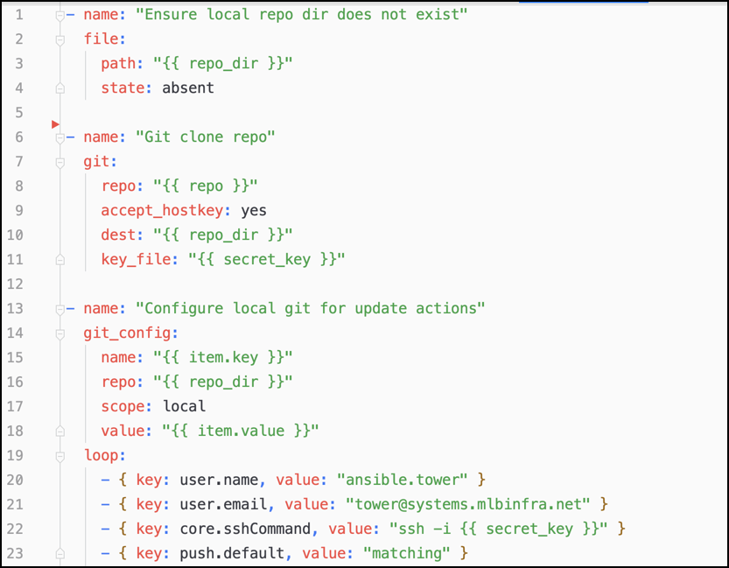
Git Clone Playbook
Goal here is to git clone the repo onto the jump-server. This requires the use of the deployment ssh-key.
Before a git push is allowed, the local git repo must be configured with some specific values.

Slide 23
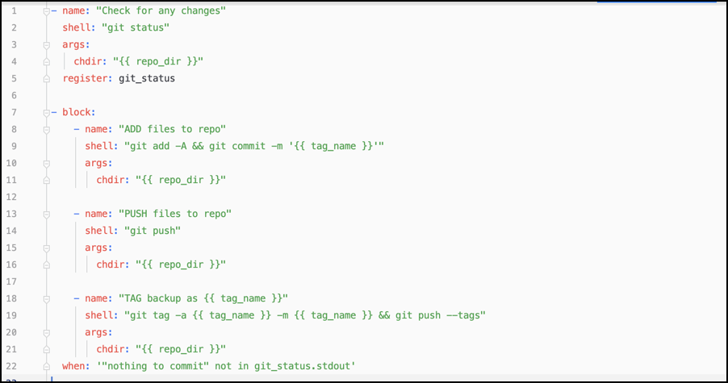
Git Push & Tag Playbook

Slide 24
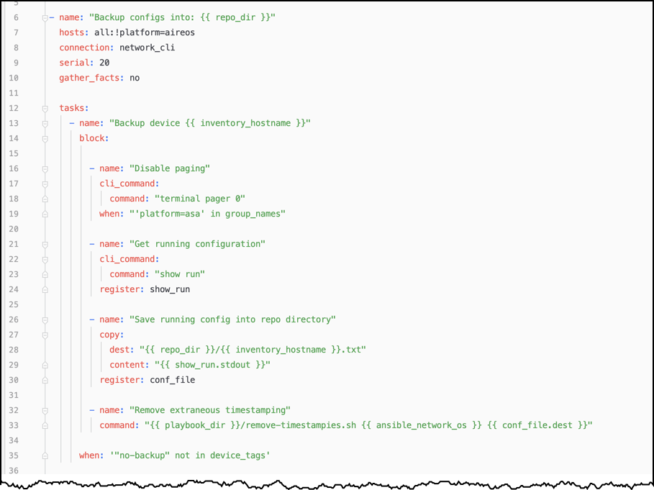
Backup for Different Platforms

Slide 25
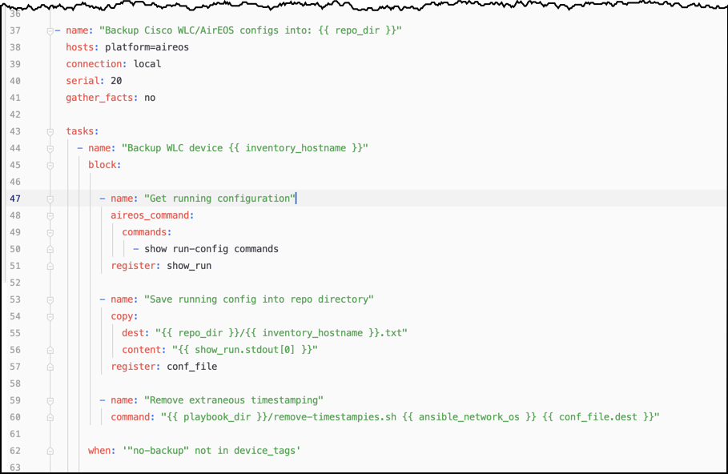
Backup for Different Platforms

